Slide 1

Final Team Project
INFO570_50SU24
Data Wrangling & Analytics
Group 10 - Krupa Gor - Angelique Hellriegel - Vanessa Hartkopf - Alison Van Orden

Slide 2

AGENDA
Introduction
Company Background
Business Problem
Our Goal
Data Selection
Data Overview
Data Description of Variables
Descriptive & Data Visualization Analysis
Descriptive Analytics
Data Visualization - Key Insights
Bar Graph - Age range
Pie Chart - Gender %
Bar Graph - Gender
Pie Chart - Preferred Music Content
Supervised Models
KNN
Logistic Regression
DecsionTree
Random Forest
Unsupervised Models (cont.)
K Means
Optimum Clusters
Conclusion
Obstacles
Conclusion
Suggestions
Future Suggestions
References & Resources

Slide 3

INTRODUCTION

Slide 4
BACKGROUND
Spotify is a Swedish music streaming company and holds 39% of the industry’s market share.
Spotify’s Mission Statement
“Our mission is to unlock the potential of human creativity - by giving a million creative artists the opportunity to live off their art and billions of fans the opportunity to enjoy and be inspired by it.”
Spotify monetizes its services from subscriptions and advertising. As of March 31, 2024, Spotify is used in 184 countries and territories and has 615 million monthly active users (MAU), which includes 239 million Premium subscribers.

Slide 5
BACKGROUND (cont.)
Growth for Premium service is 14% and MAU’s is 19% from March 2023 to March 2024. Spotify’s Ad-Support growth is 22%, but it is seasonal with greater demand during the holiday season and a higher Ad revenue in the fourth quarter. The first quarter there is a seasonal decline.
To increase revenue Spotify is expanding to audiobooks, podcasts and new global markets.
Spotify’s Revenue comes from:
87% is from Premium (paid) Services
Ad-supported Free Service MAU (361 million)

Slide 6
BUSINESS PROBLEM
How can Spotify increase revenue through current and potential users?
Spotify is one of the leading music streaming services in the world, but does not make a profit. Spotify claims that trial programs increase Premium (pay for service) subscriber growth.
We need to explore the following areas of concern:
Retention avoid Churn
Individual user conversion from free to paid service
Customers that use free Ad services
Entice new potential users
Review the competition

Slide 7
OUR GOAL
First,.we need to look at the potential Spotify users that use the free service and determine what factors will influence their decision to subscribe to Spotify’s paid services. We will build a model to predict Spotify users and examine the customer profiles. Segmentation will focus on specific target groups. Spotify can then develop a marketing strategy and campaigns to target specific users and increase customer conversion from free service to paid service and in the process reduce churn.
In the future, we also need to briefly assess the competition to fine tune the marketing strategy and suggest new innovations that meet the customer’s needs. This will help Spotify gain an overall competitive advantage for the future and maximize profits.

Slide 8
OUR GOAL (cont.)
What we want to achieve and the implications of the project:
Break customers down into segments to identify distinct patterns between users and unique customer segments
Segment customers to allow Spotify to target marketing and promotional campaigns to increase usage and reduce churn
Utilizing the insights gathered from the customer segmentation, Spotify will be able to target specific communications, marketing campaigns and promotions to the relevant customer segments
Segmentation will provide Spotify with insights regarding their customers that they can utilize to broaden their offerings and appeal to different customer segments with future updates and features

Slide 9
DATA SELECTION
https://www.kaggle.com/datasets/meeraajayakumar/spotify-user-behavior-dataset
The Spotify User Behavior Dataset reveals user behavior on the Spotify platform. It details Spotify users' interaction patterns, engagement metrics and listeners’ music habits.
Why this particular dataset?
We chose the Spotify User Behavior Dataset for our final project because it offers rich data on user interaction, music consumption, and engagement, which aligns with our shared interest in music. Our group consists of members from diverse professional and educational backgrounds. Despite our different fields, we are all Spotify users, and two of us are musicians. This unique combination allows us to leverage our varied expertise to conduct a comprehensive analysis, making our project both insightful and multifaceted.

Slide 10
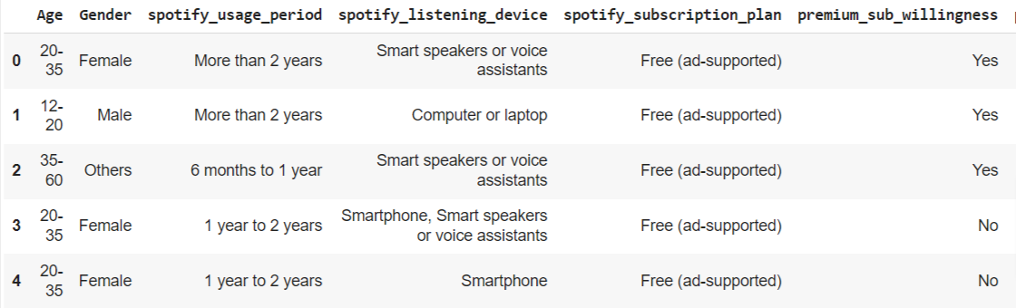
DATA OVERVIEW - RAW DATA
The raw dataset was relabeled to Spotify_user.csv for ease of manipulation in Pandas. The following is a sample of the raw data used for this project.
Raw Data from - https://www.kaggle.com/datasets/meeraajayakumar/spotify-user-behavior-dataset

Slide 11
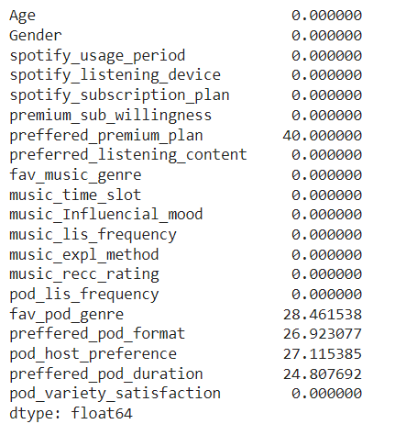
DATA OVERVIEW (cont.)
The data is a collection of user behavior information from current Spotify users. The data will be used to predict the target group willing to convert to a premium (paid) Spotify subscription.
The dataset from Kaggle consists of 520 rows and 20 columns. The size is 10,400 and includes null values.
The data had missing values and the percentage for each variable of missing values are demonstrated in the chart.
Preferred_premium_plan 40%
Fav_pod_genre 28%
Preferred_pod_format 27%
Pod_host preference 27%
Preferred_pod_duration 25%

Slide 12
DATASET DESCRIPTION - VARIABLES
Age - Age group of user Gender - Gender of user spotify_usage_period - How long have you been using Spotify spotify_listening_device - Which of the following devices do you primarily use to listen to Spotify spotify_subscription_plan - Which Spotify subscription plan do you currently have premium_sub_willingness - Are you willing to take a premium subscription or willing to continue with premium subscription in future preffered_premium_plan - If premium or willing to take premium, what amount do you pay for the subscription preferred_listening_content - What do you prefer to listen more fav_music_genre - What genre(s) of music do you enjoy the most music_time_slot - What is your favourite time slot to listen to music
music_Influencial_mood - When it comes to listening to music, which of the following moods or situations most strongly influences your choice of music music_lis_frequency - When do you listen to music more often music_expl_method - How do you discover new music on Spotify music_recc_rating - How do you rate the spotify music recommendations pod_lis_frequency - How often do you listen to Podcast fav_pod_genre - What genre(s) of Podcast do you enjoy the most preffered_pod_format - What podcast format you generally prefer pod_host_preference - Are you more inclined to listen to podcasts from unknown personalities, or do you prefer podcasts hosted by well-known individuals

Slide 13
DESCRIPTIVE ANALYSIS
&
DATA VISUALIZATION

Slide 14
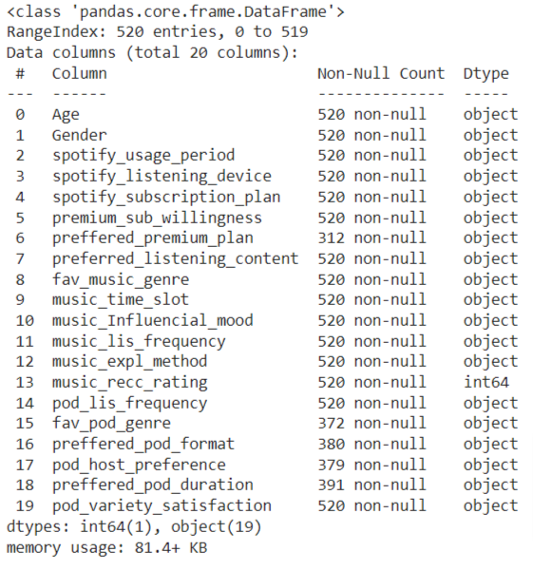
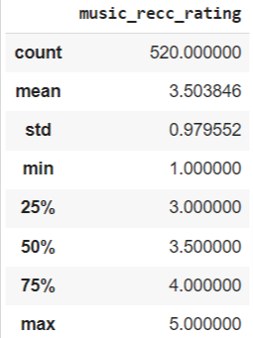
DESCRIPTIVE ANALYTICS
Most variables were objects(strings) within the dataset except for the (float) music recommendation rating

Slide 15
DATA VISUALIZATION - KEY INSIGHTS
The data was manipulated into visuals and predictive models for Spotify to examine and review.
Age and gender are promising prospects and revealed a potential market for future users of premium (paid) services.
Spotify users’ listening choice was also considered and valuable information that could be incorporated into Spotify’s overall marketing strategy.

Slide 16
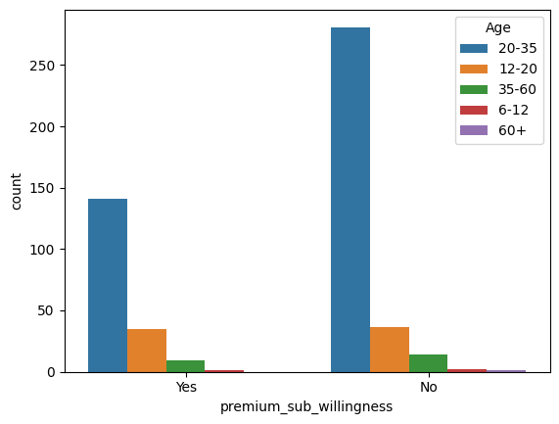
DATASET VISUALIZATION - AGE
Ages 12-20 (n = 71)
51% Unwilling to Subscribe to Premium
49% Willing to Subscribe to Premium
Ages 20-35 ( n = 422)
66.6% Unwilling to Subscribe to Premium
33.4% Willing to Subscribe to Premium
Ages 30-60 (n = 14)
60.9% Unwilling to Subscribe to Premium
39.1% Willing to Subscribe

Slide 17
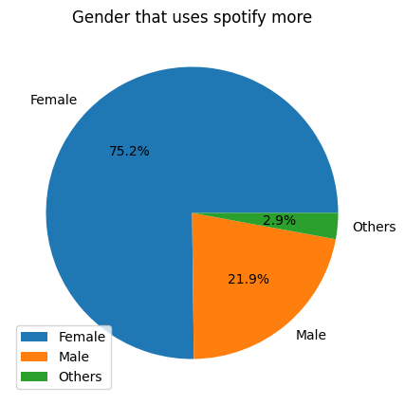
VISUALIZATION - GENDER %
Our dataset (n = 520) was comprised of:
391 “Female”
114 “Male”
15 “Others”

Slide 18
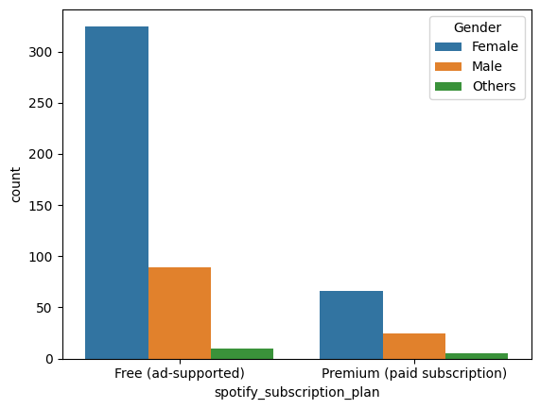
VISUALIZATION - USERS by GENDER
Of the users in the dataset:
325 Female used the Free Subscription Plan
66 Female used the Paid Subscription Plan
89 Male used the Free Subscription Plan
25 Male used the Paid Subscription Plan
10 Others used the Free Subscription Plan
5 Others used the Paid Subscription Plan
This means only 16.88% of Female users subscribed to the Premium Plan while 21.9% of Male users subscribed to the Premium Plan.

Slide 19
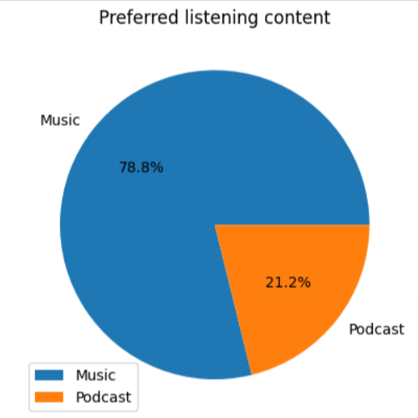
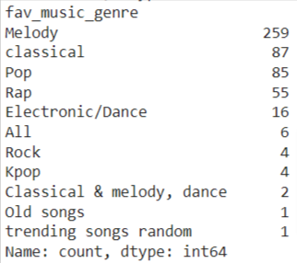
VISUALIZATION - PREFERRED CONTENT

Slide 20
DATA MODELING

Slide 21
PREPROCESS & MODELS
The Raw Data, consisting of objects(string data) was preprocessed by
encoding dummy variables and zero variance variables were dropped.
To Fit the Model, the labelencoder was applied to a list of variables to transform null values. The data was split and training data was developed and used to create the models. The data was also processed and balanced before running the models.
The Models shown used both Supervised and Unsupervised Learning to obtain a clearer picture, a broad and finite view, of the target audience.
Spotify will then be able to make better decisions for a comprehensive marketing strategy.

Slide 22
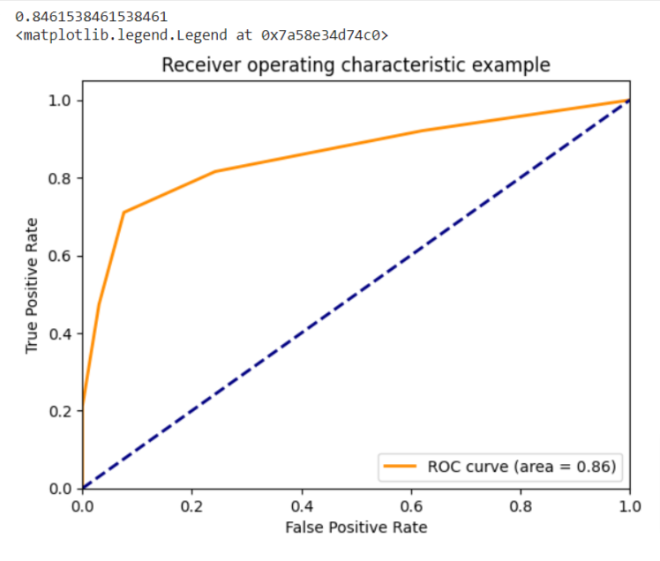
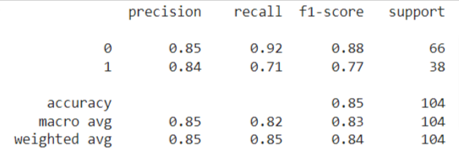
KNN REGRESSION MODEL - (supervised)
The KNN Regression Model shows an 85% accuracy

Slide 23
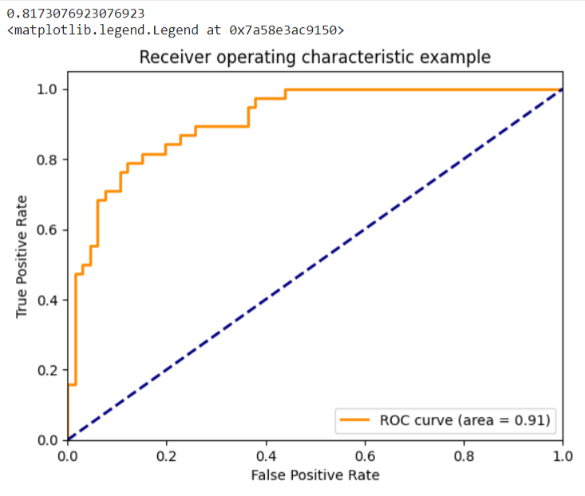
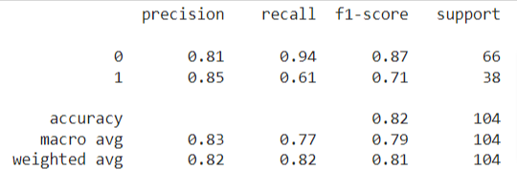
LOGISTIC REGRESSION MODEL - (supervised)
The Logistic Regression Model shows an 82% accuracy

Slide 24
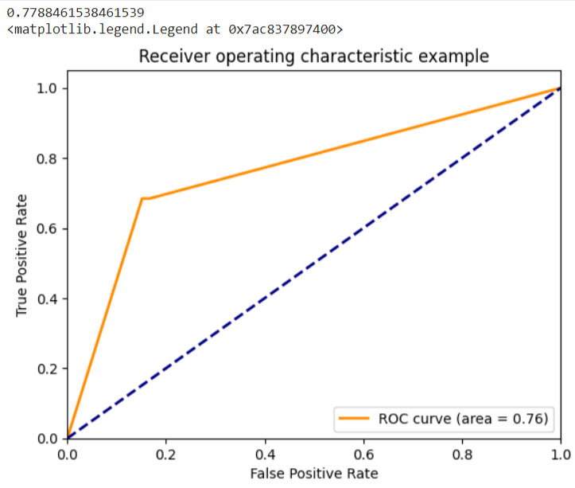
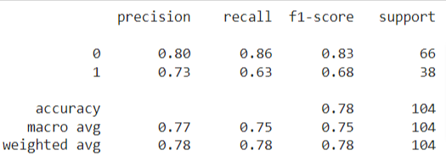
DECISION TREE MODEL - (supervised)
The Decision Tree Model shows a 78% accuracy

Slide 25
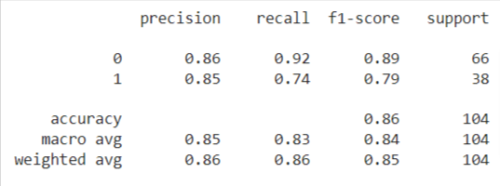
RANDOM FOREST MODEL - (supervised)
The Random Forest Model shows the best accuracy at 86%.

Slide 26
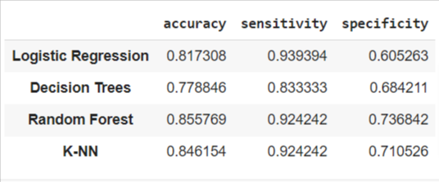
SUPERVISED MODEL RESULTS
Out of all the supervised models, the Random Forest Model shows the best accuracy at 86%, specificity at 74% and sensitivity at 92%.

Slide 27
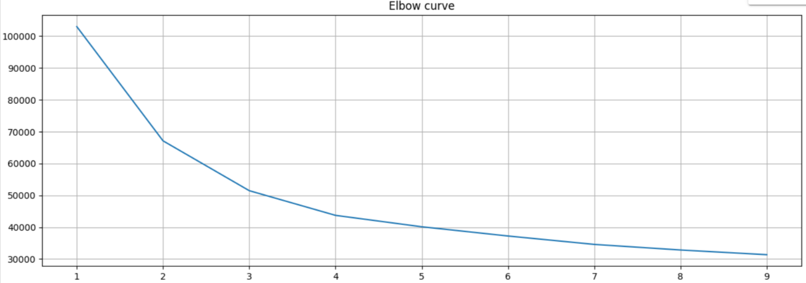
K-MEANS MODEL - (unsupervised)
The elbow shows that K is at 2 and then continues to dip. The clustering of data points by minimizing variance in each cluster.

Slide 28
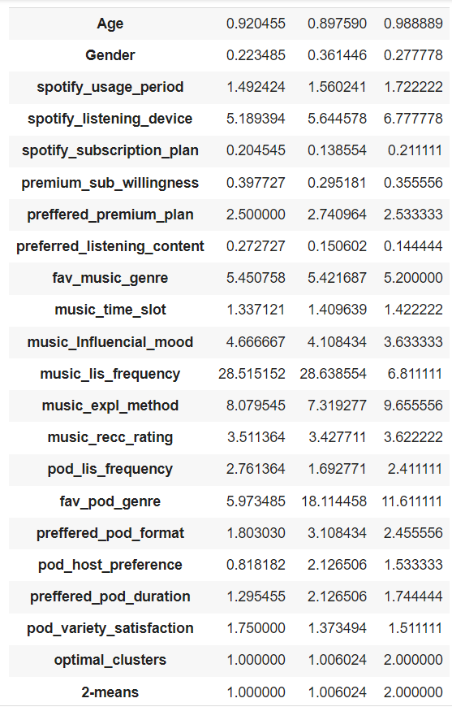
OPTIMUM CLUSTERS
Age
20-35 37
12-20 23
35-60 5
6-12 2
Premium_sub_willingness
Yes 42
No 25

Slide 29
CONCLUSION

Slide 30
CONCLUSION
In this dataset, we found that more Females than Males or Others listened to Spotify
Females are more likely to sign up for the premium as well
Individuals ages 20-35 were represented in our dataset, and seemed to use Spotify more than the other age ranges included
More users preferred to listen to music (78.8%) over podcasts and other content (21.2%) on Spotify

Slide 31
OBSTACLES
Converting categorical variables to make a measurable output
Creating categorical variables from binary variables
Dataset specific obstacles:
Age range was broad grouping (ex. 12-20) instead of exact ages
Age ranges overlapped (ex. 12-20 and 20-35; 20 year old could have selected either group)
Lack of sociodemographic variables of interest (average household income, level of education, race/ethnicity, occupation, etc.)
Interpretation of Python output

Slide 32
SUGGESTIONS
Spotify has a student discount for $5.99 a month. Presently, Spotify only allows college students (18+) to utilize this discount. As 12-20 year olds comprise Spotify’s second largest audience, Spotify should consider offering this promotion to middle and high school students as well, lowering the threshold age to 12. This would entice younger users to sign up for the discount, increasing initial revenue and potentially creating lifetime subscribers, assisting with retention.
Use data analytics to send personalized recommendations and offers to free users based on their listening habits.
Create interactive and customizable playlists that are only available to Premium users

Slide 33
SUGGESTIONS (cont)
The majority of Spotify users included in this dataset prefer Music (78.8%) to Podcasts and other content (21.2%). Spotify needs to capitalize on this disparity and ensure their music offerings are up-to-date, relevant and the focus of their advertising campaigns.
As younger individuals, 12-20 and 20-35, are the most likely to sign up for Premium plans, Spotify should spend their marketing dollars on creating targeted campaigns with up-and-coming as well as current musicians, focusing less on musicians who were more popular a few decades ago.
Spotify usage period and listening time slot (morning, afternoon, night) were correlated; Spotify should curate targeted playlists for each of these time slots to increase retention.

Slide 34
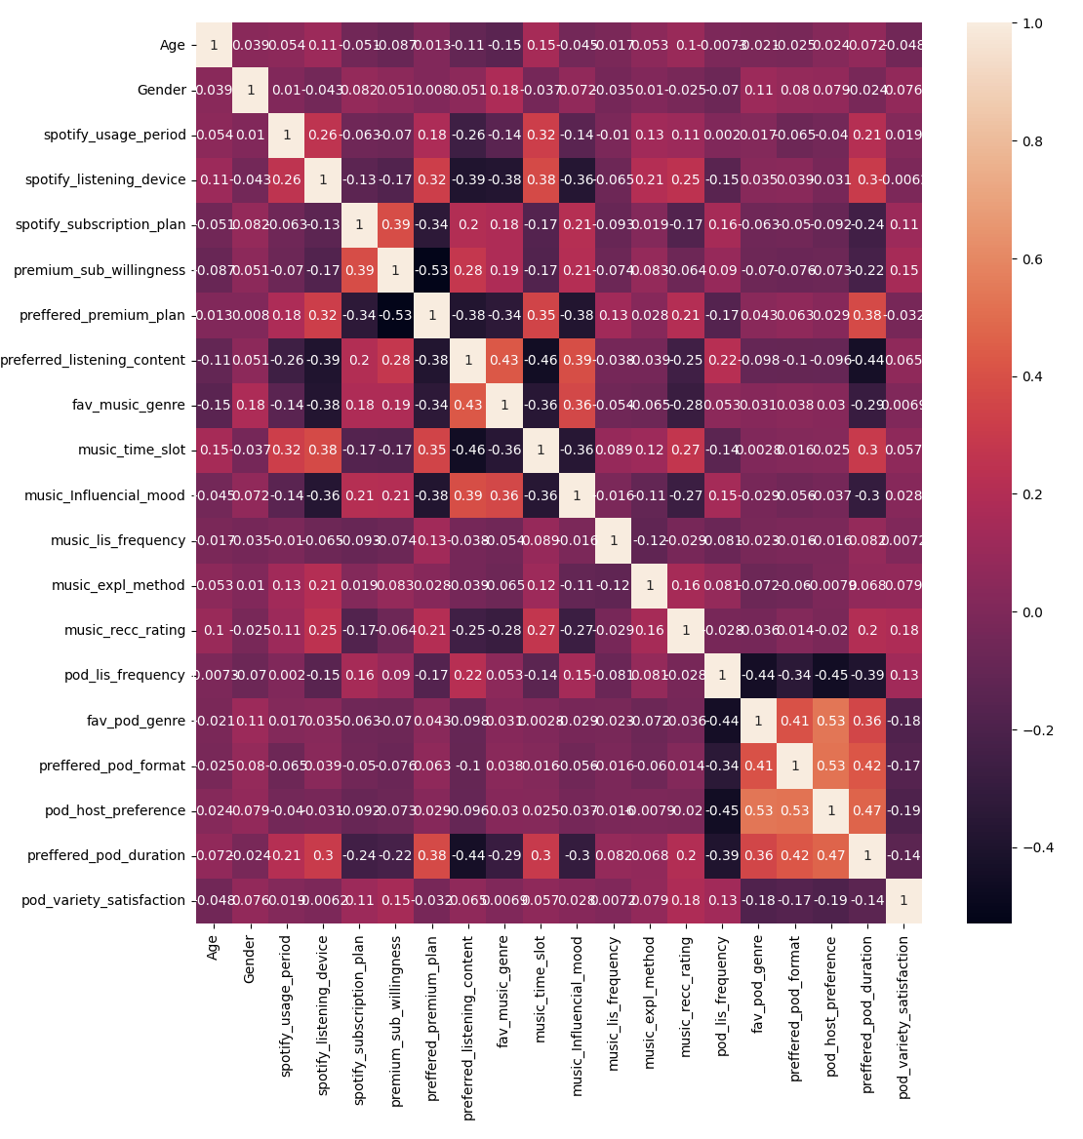
SUGGESTIONS (cont)
As price paid for Spotify Premium plan increases, willingness to continue to pay for Premium plan decreases. Spotify needs to address this relationship, perhaps by offering incentives that significantly discount Premium memberships if individuals sign on for annual or multi-year contracts.

Slide 35
FUTURE RESEARCH SUGGESTIONS
Spotify should seek to collect more demographic information about their customers so future segmentation will be better informed and include variables such as household income, level of education, and other socioeconomic factors.
Spotify should conduct research on their competitors’ offerings (Apple Music) and analyze the gaps in their own current offerings when compared to the larger market.
Carry out market research studies to identify the drivers of customer subscription and retention.

Slide 36
REFERENCES
&
RESOURCES

Slide 37
REFERENCE - SPOTIFY PREMIUM PLANS
Preferred Premium Plan
Individual Plan -Rs 119/month - data count 95
Student Plan -Rs 59/month - data count 94
Duo Plan 149/month - data count 84
Family Plan -Rs 179/month - data count 39

Slide 38
RESOURCES
DATASET from Kaggle - Spotify_user.csv
Ajayakumar, M. (2023, July 6). Spotify_User_Behavior_Analysis. Kaggle.
https://www.kaggle.com/datasets/meeraajayakumar/spotify-user-behavior-dataset
COMPANY RESEARCH:
BBC. (2018, March 1). How spotify came to be worth billions. BBC News. https://www.bbc.com/news/newsbeat-43240886
Bertoni, S. (2024, February 21). Spotify has plans to move beyond music and become the Instagram and tiktok of audio. Forbes. https://www.forbes.com/sites/stevenbertoni/2021/11/29/spotify-has-plans-to-move-beyond-music-and-become-the-instagram-and-tiktokofaudio/
Python. (2024). Welcome to Python.org. Python.org. https://www.python.org/success-stories/python-seo-link-analyzer/
Spotify. (2024). Spotify - investor relations. Spotify Investment Relations. https://investors.spotify.com/home/default.aspx

